Slide 1
LunarExplorer Reinforcement Learning
Double Deep Q-Network with Lunar Lander

Slide 2
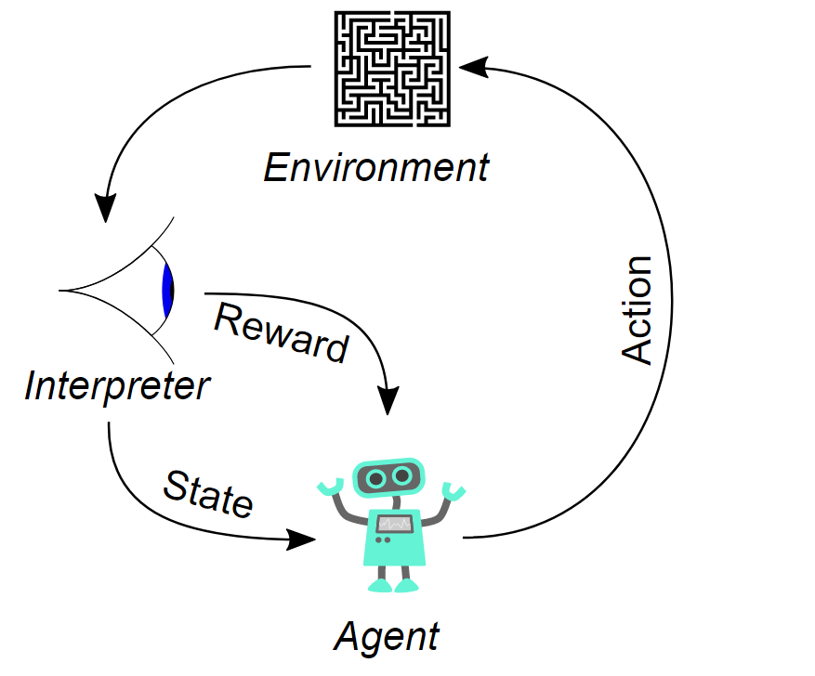
Reinforcement Learning
a machine learning training method
learn by interacting
receive rewards (positive or negative)

Slide 3
Lunar Lander
part of the Box2D Gymnasium environments
a classic rocket trajectory optimization problem
Action space
Observation
Reward
Completeness
4 possible actions
8 dimensional array
Modified
When landed or crashed

Slide 4
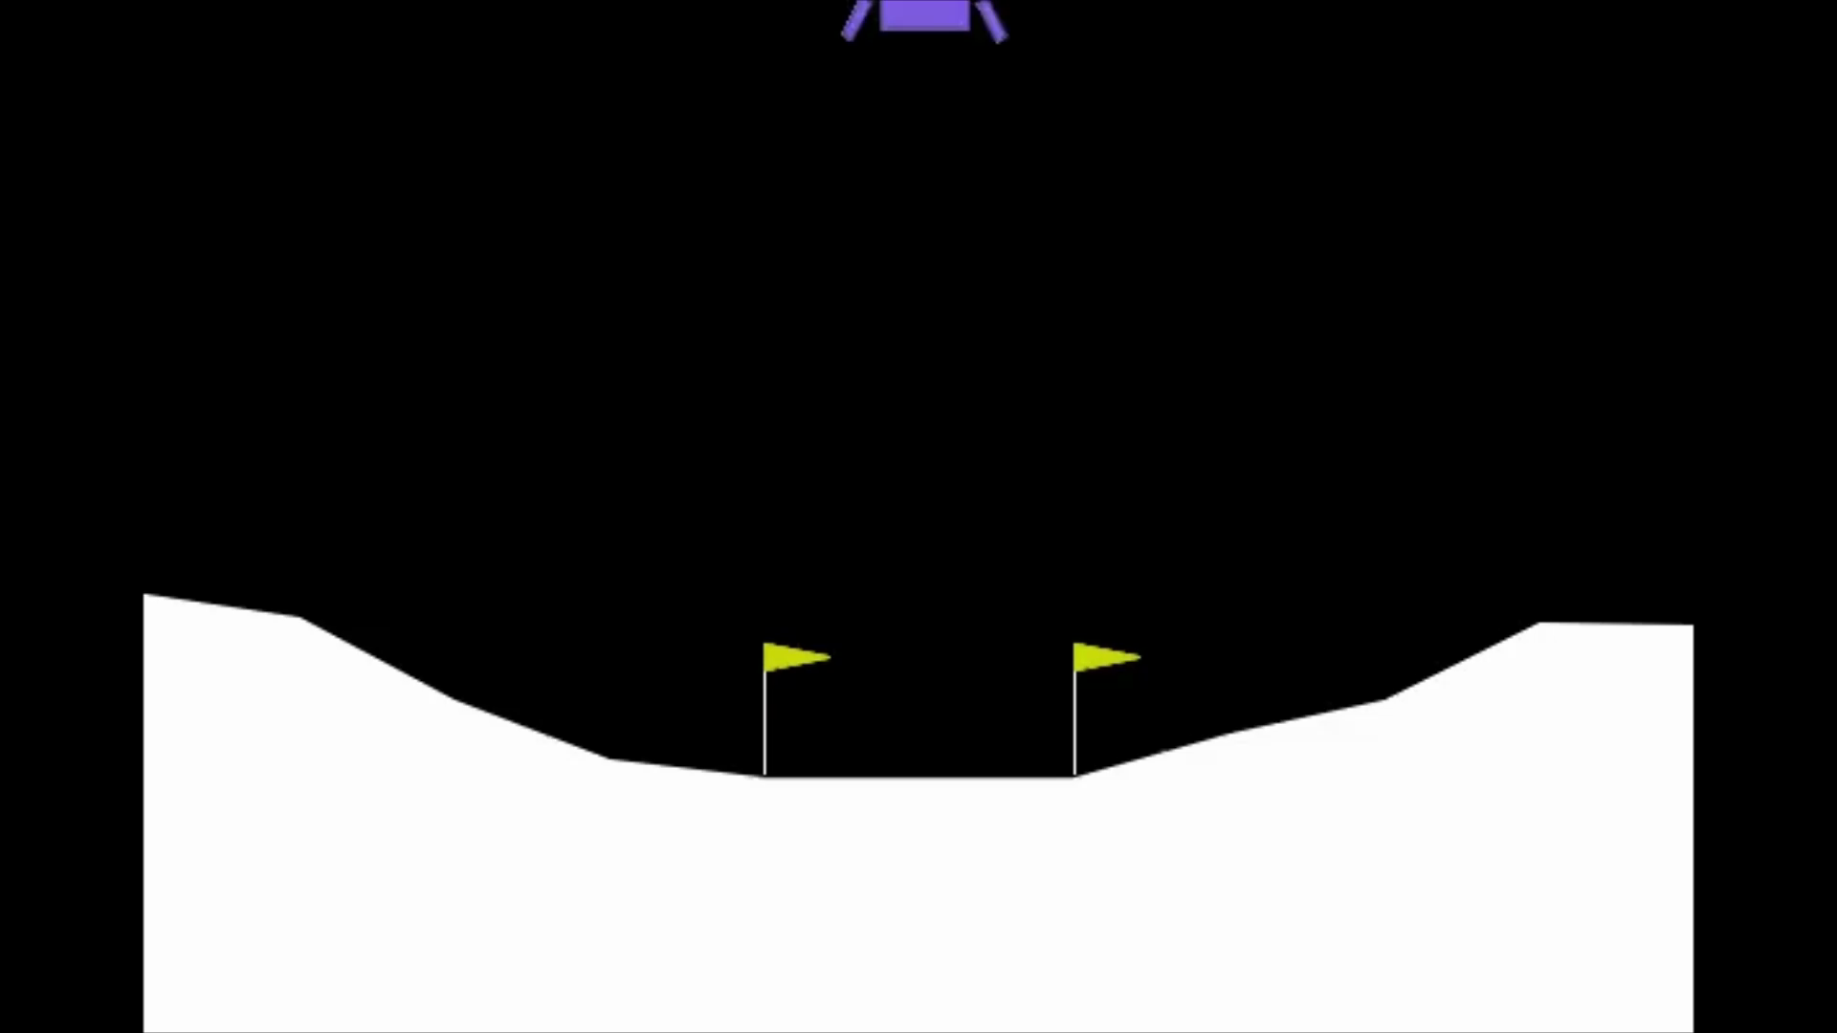
Lunar Lander - random actions

Slide 5
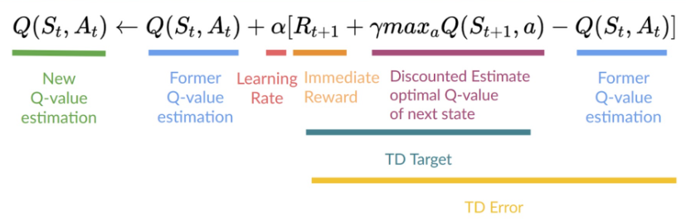
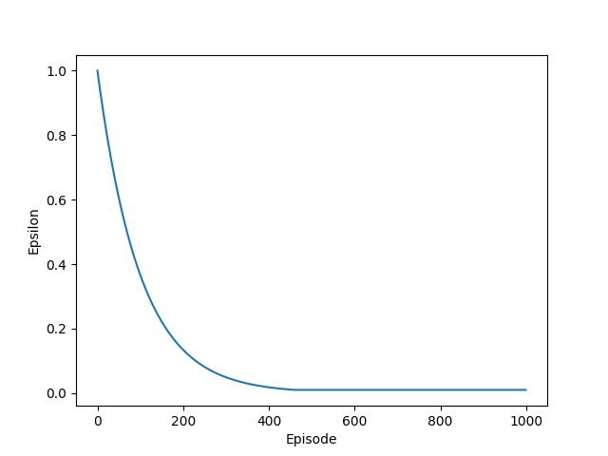
Q-Learning
Off-policy method
Value-action function
Q - Quality (value) of that action at that state
Q-table
ε-Greedy strategy
 | Do nothing | Fire left engine | Fire main engine | Fire right engine
 | 0.42 | 0.03 | 0.78 | 1.93
 | 0.25 | 1.78 | 0.92 | 0.10
 | 1.34 | 0.52 | 0.89 | 0.21
... | ... | ... | ... | ...

Slide 6
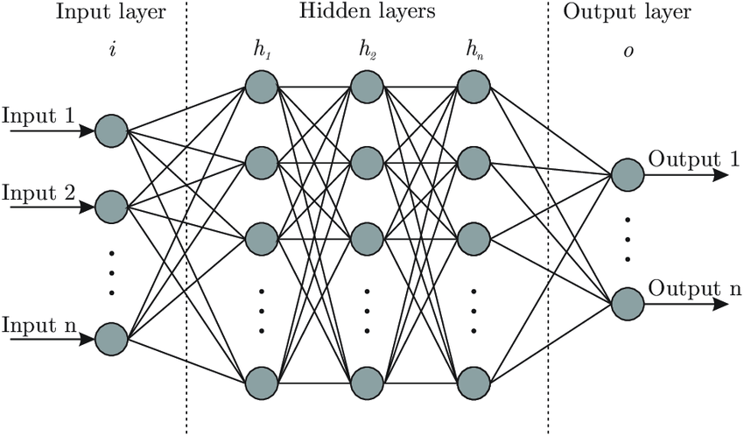
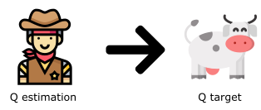


Double Deep Q-Network (DDQN)
Neural Network (function apprximation)
Experience Replay

Slide 7
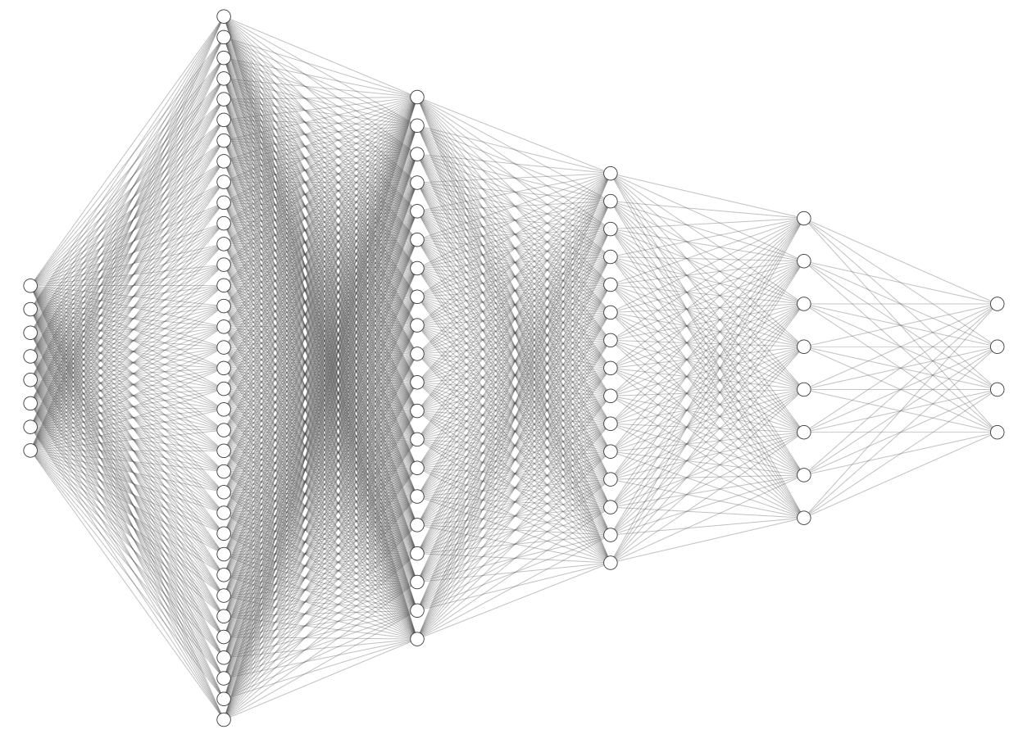
Neural Network Arhitecture
Input layer - 8 neurons
Hidden layer 1 - 512 neurons
Hidden layer 2 - 256 neurons
Hidden layer 3 - 128 neurons
Hidden layer 4 - 32 neurons
Output layer - 4 neurons
173.100 parameters

Slide 8
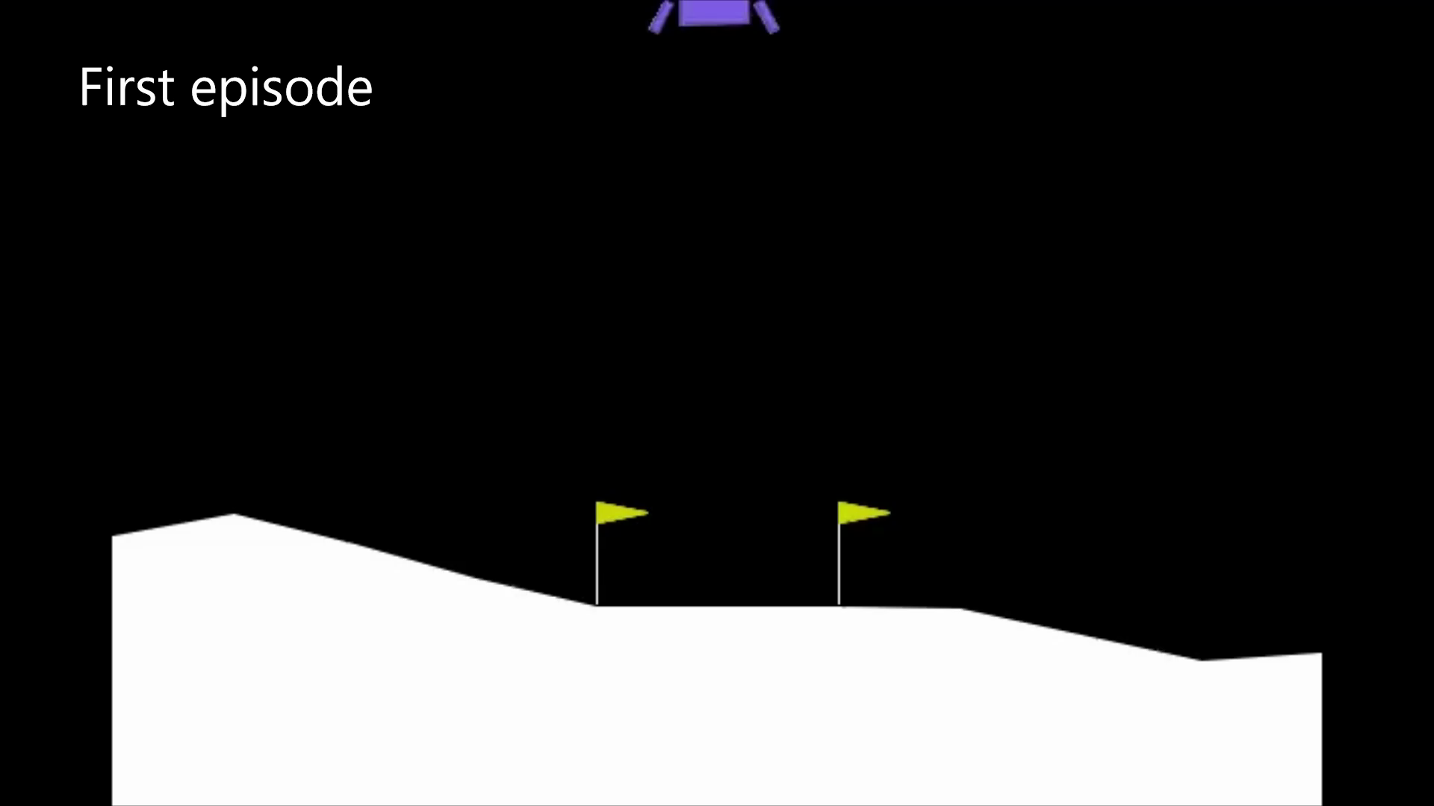
Lunar Lander - agent actions during training

Slide 9
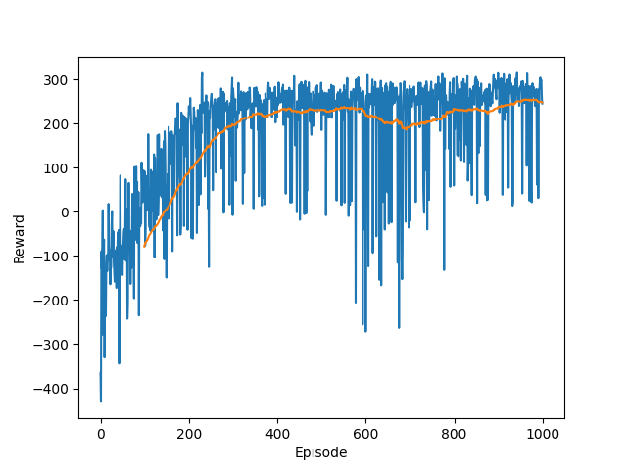
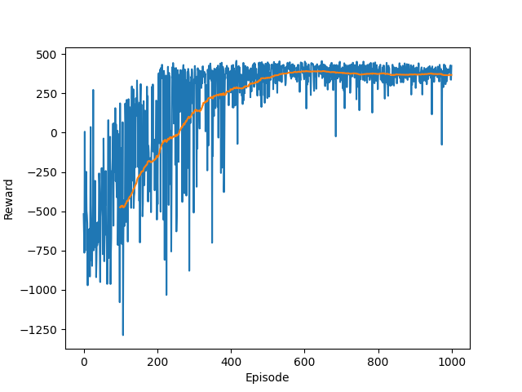
Lunar Lander - rewards (my contribution)
After 50000 episodes played
Default
99.3% landing accuracy
0.7% crashes
Training: ~ 30 min (GPU)
99.6% landing accuracy
0.4% crashes
Modified version
Training: ~ 7 min (GPU)

Slide 10
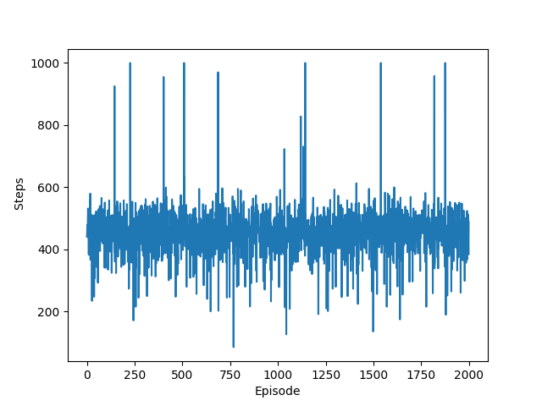
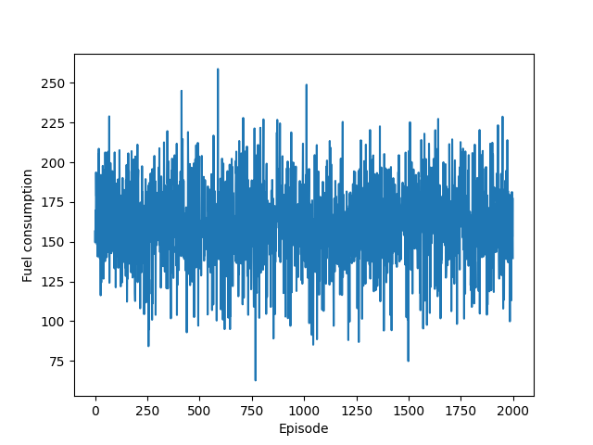
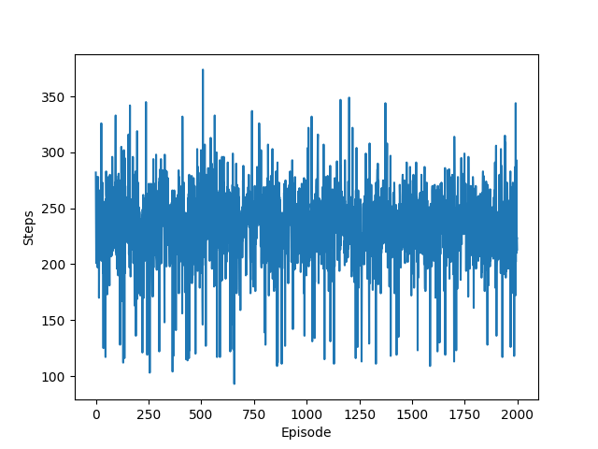
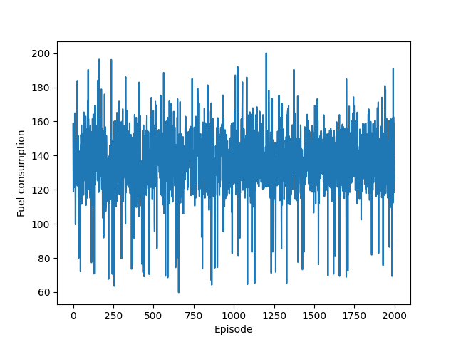
Lunar Lander - rewards (my contribution)
Default
Modified version

Slide 11
Problems encountered Conclusion
Different network architectures
Tuning hyper-parameters
Time allocated to training
Changes to rewards
Successfully working agent
Efficiency
Expand the environment
Different approaches (PPO)

Slide 12
Q&A

